Slide 1

Building Deep Learning Applications
Optimization Methods
https://images7.memedroid.com/images/UPLOADED554/62b86182b3f34.webp
Presented by: 112C71001 陳本瑜

Slide 2
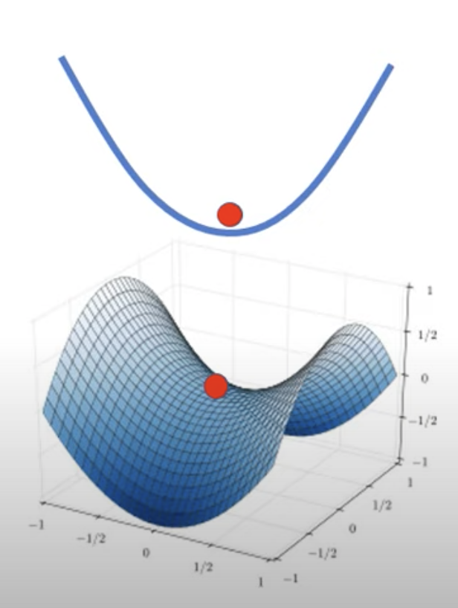
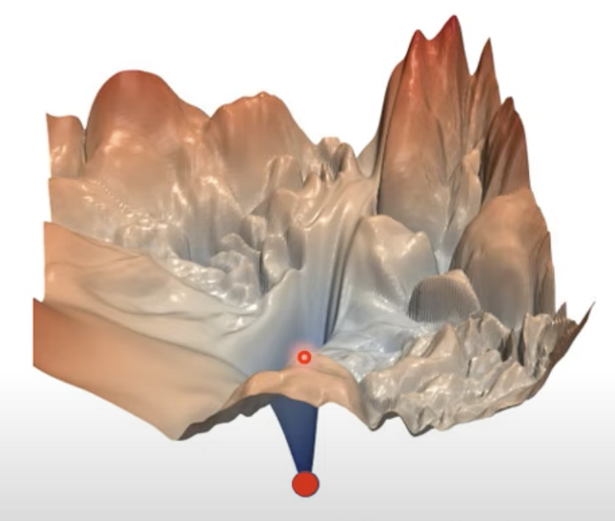
Building Deep Learning Applications
Optimization Methods
Image source: Hung-yi Lee【機器學習2021】機器學習任務攻略
https://www.youtube.com/watch?v=WeHM2xpYQpw&list=PLJV_el3uVTsMhtt7_Y6sgTHGHp1Vb2P2J&index=4
Presented by: 112C71001 陳本瑜

Slide 3

Optimization Methods
Topics:
1) Introduction
2) Gradient Descent
3) Variants of Gradient Descent
4) Advanced Optimization Algos.
5) Something helps optimization
6) Conclusion
Source:https://www.pinterest.com/pin/214624738467655137/
Presented by: 112C71001 陳本瑜

Slide 4
Optimization Methods
References:
Websites:
- https://uvadlc-notebooks.readthedocs.io/en/latest/tutorial_notebooks/tutorial4/
Youtube Videos:
- [Hung-Yi Lee]. (2021, March 5). 機器學習 2021 [Video]. Youtube. https://www.youtube.com/playlist?list=PLJV_el3uVTsMhtt7_Y6sgTHGHp1Vb2P2J
- [陳縕儂 Vivian NTU MiuLab]. (2023, September 14). 台大資訊 深度學習之應用 [Video]. Youtube. https://www.youtube.com/playlist?list=PLOAQYZPRn2V4jYwTGKUH4YaU6NE6VROZX
Published papers:
- Keskar et al., 2017; On Large-Batch Training for Deep Learning: Generalization Gap and Sharp Minima , https://arxiv.org/abs/1609.04836
Presented by: 112C71001 陳本瑜

Slide 5
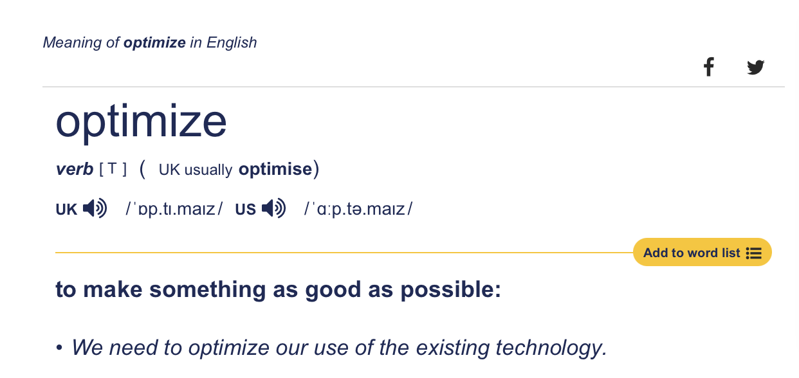
Introduction
Q1: What is optimization in deep learning?
Q2: Why do we need optimization in training deep neural networks?
Definition from Cambridge Dictionary
Ok, but in the context of deep learning what are we optimizing? What’s there to optimize?
deep learning,optimization,training

Slide 6
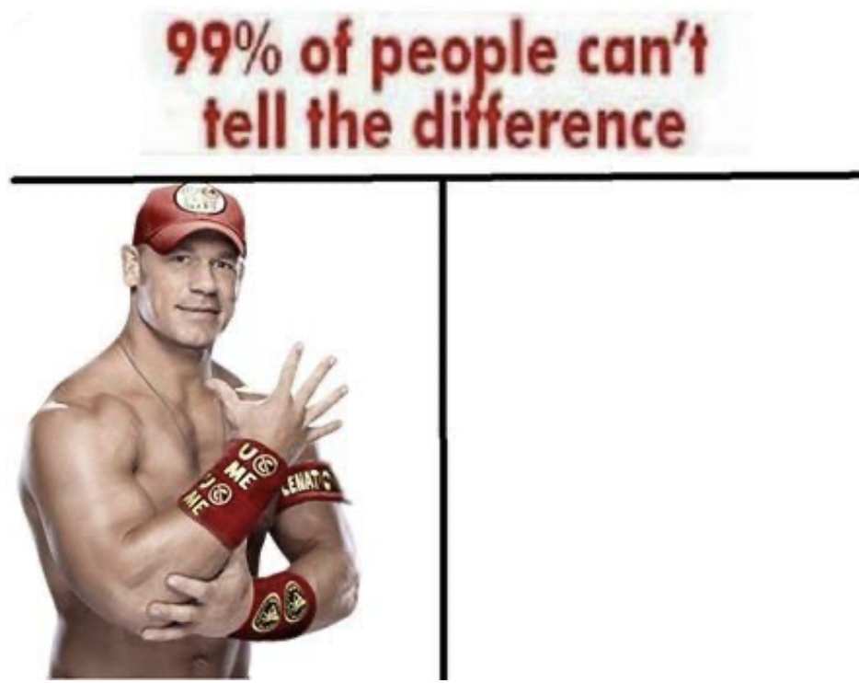
Introduction
Traditional Programming
Input
Computer
Output
Function/Rules
Machine Learning (including DL)
Input
Computer/Model
Function/Rules
Output
Image source: https://www.pinterest.com/pin/134896951317012523/
deep learning,optimization,training

Slide 7


Introduction
Q1: What is optimization in deep learning?
Q2: Why do we need optimization in training deep neural networks?
A very, very basic workflow …
Model
(some big function)
Input x
Output $\hat{y}$
Some tensors
Calculate the loss
what are we optimizing? this
Ground Truth y
$$Loss=L(\hat{y}, y)$$
Goal: we want the loss to be as small as possible
deep learning,optimization,training
Huh ?
Huh ?
Huh ?

Slide 8


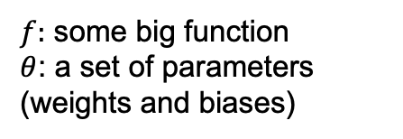
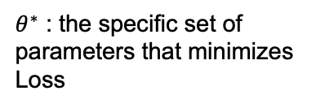

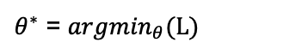


Introduction
Q1: What is optimization in deep learning?
Q2: Why do we need optimization in training deep neural networks?
$$Loss=L(\hat{y}, y)$$
Step 1:
Function with unknown parameters
Step 2:
Define Loss from training data
Step 3:
Optimization
$$\hat{y}=f_{θ}(x)$$
$θ^{∗}$ = ${argmin}_{θ}(L)$
$$Loss=L(\hat{y}, y)$$
$f:$ some big function
$θ$: a set of parameters (weights and biases)
$$Loss=L(\hat{y})$$
$θ^{∗}$ : the specific set of parameters that minimizes Loss
$$Loss=L(θ)$$
deep learning,optimization,training
Goal achieved: loss to be as small as possible
Notes:
Remember from the previus slide, we said Loss is a function of y_hat and y
Since between y and y_hat, the only adjustable values are y_hat and also since
Y_hat is depended on theta, we can write the Loss function as a function a theta
The next step is to optimize the set of parameters that minimize the loss
How do we find this set of parameters?

Slide 9


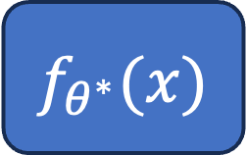
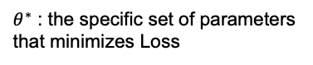
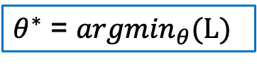
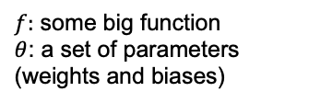
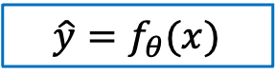
Introduction
$$\hat{y}=f_{θ}(x)$$
optimized model
$f:$ some big function
$θ$: a set of parameters (weights and biases)
$$f_{θ^{∗}}(x)$$
$θ^{∗}$ = ${argmin}_{θ}(L)$
$θ^{∗}$ : the specific set of parameters that minimizes Loss
Validation set?
Model bias?
… and other considerations
Not the focus today ☹
Test data
deep learning,optimization,training
Notes:
And then you use your theta_star parameters and chug it in your function (or model)
To have a “optimized” model … and then you send in your test data
Hoping everything works out perfectly
More Often that not, you get bad results – trash basically

Slide 10
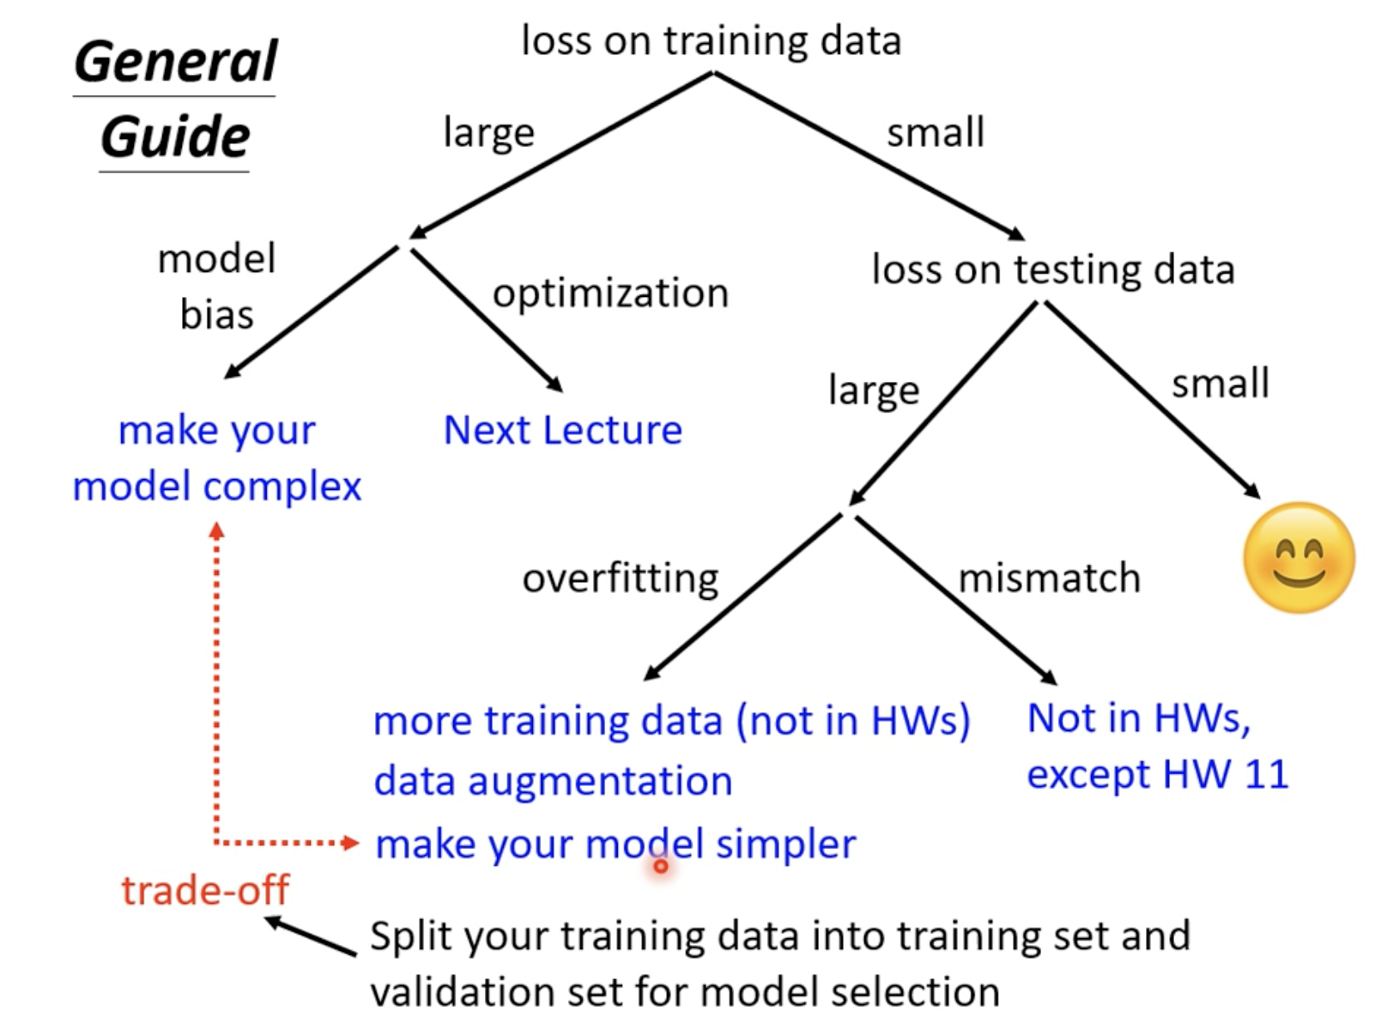
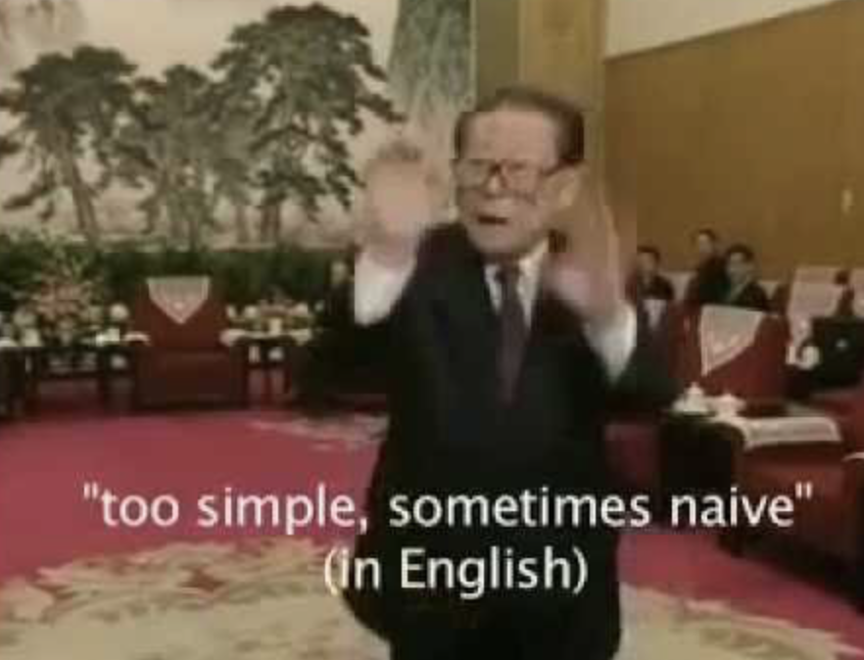
Introduction
Model bias ?
Image source: Hung-yi Lee【機器學習2021】機器學習任務攻略
https://www.youtube.com/watch?v=WeHM2xpYQpw&list=PLJV_el3uVTsMhtt7_Y6sgTHGHp1Vb2P2J&index=4
https://makeameme.org/meme/when-u-high-5c13ea
Notes:
If we look at the figure on the right,
When we have a large loss during training, it could be
Either model bias: which means we’re trying to learn a complex distribution with a model that’s too simple
OR
It could just be an optimization problem: in this case, we should try other optimization methods.
Which bring us to the main topics for today in the next slide …

Slide 11
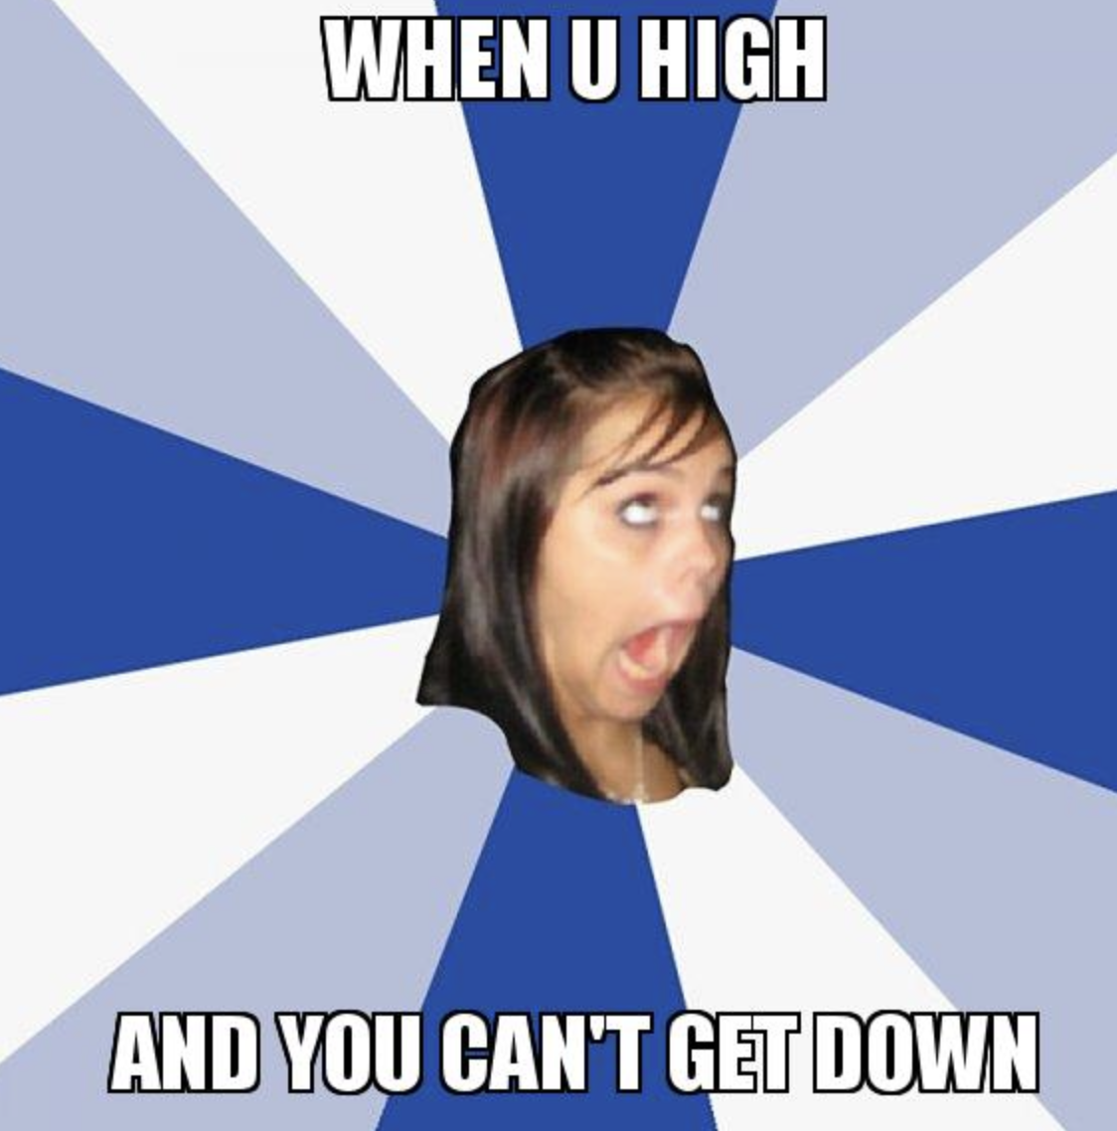
Introduction
During training, we just can’t get it down
Image source: Hung-yi Lee【機器學習2021】機器學習任務攻略
https://www.youtube.com/watch?v=WeHM2xpYQpw&list=PLJV_el3uVTsMhtt7_Y6sgTHGHp1Vb2P2J&index=4
https://makeameme.org/meme/when-u-high-5c13ea
Notes:
If we look at the figure on the right,
When we have a large loss during training, it could be
Either model bias: which means we’re trying to learn a complex distribution with a model that’s too simple
OR
It could just be an optimization problem: in this case, we should try other optimization methods, we might need a more suitable optimizer …

Slide 12
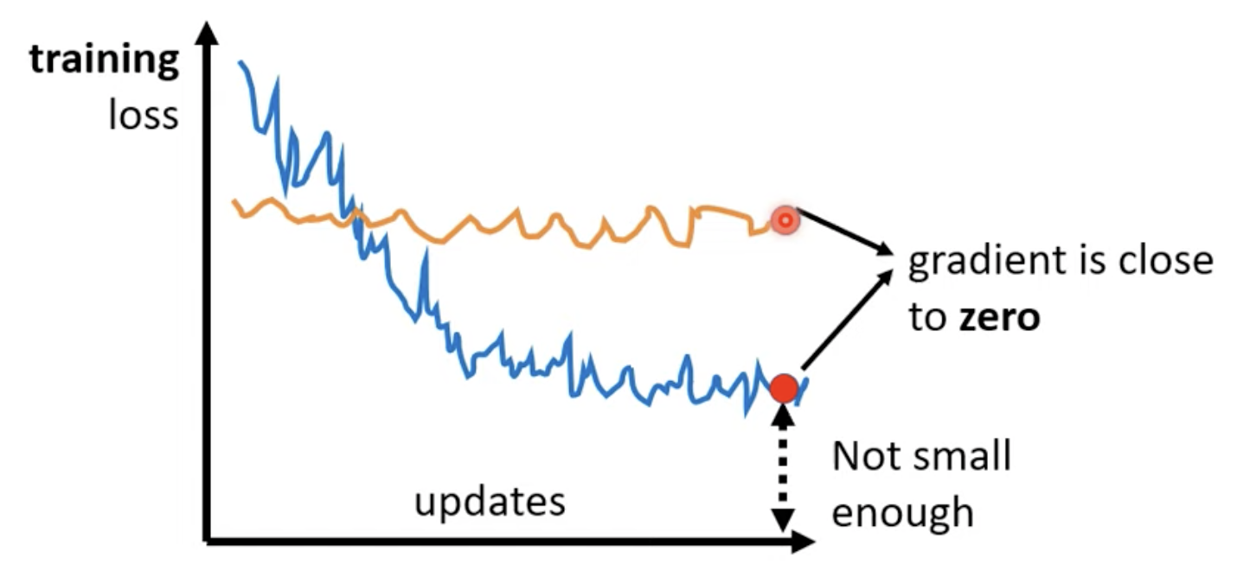
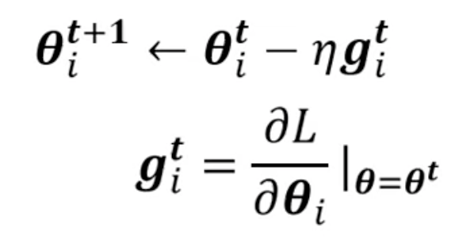
Introduction
During training, we just can’t get it down, BUT why is that?
Optimization algo
Image source: Hung-yi Lee【機器學習2021】機器學習任務攻略
https://www.youtube.com/watch?v=WeHM2xpYQpw&list=PLJV_el3uVTsMhtt7_Y6sgTHGHp1Vb2P2J&index=4
https://makeameme.org/meme/when-u-high-5c13ea
Notes:
As we see on the right, the training loss curve is not moving downwards,
Which indicates that the gradient is very small or close to zero.
Here theta_i refers to one of the parameters in the model
Superscript t means at step t (or epoch t)
eta (n shaped symbol) is the learning rate
G_i is the partial derivate of Loss wrt theta_i evaluated at theta = theta_t

Slide 13
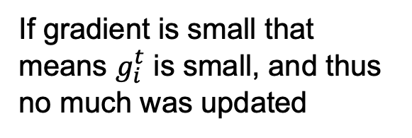
Introduction
If gradient is small that means $g_{i}^{t}$ is small, and thus
no much was updated
Optimization algo
Why would the gradient be small?
Image source: Hung-yi Lee【機器學習2021】機器學習任務攻略
https://www.youtube.com/watch?v=WeHM2xpYQpw&list=PLJV_el3uVTsMhtt7_Y6sgTHGHp1Vb2P2J&index=4

Slide 14
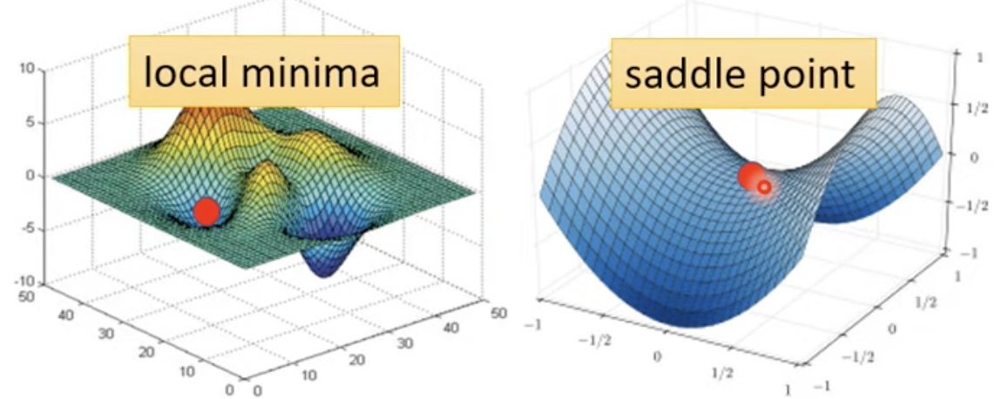
Introduction
Plain vanilla loss curve
You don’t just get stuck at a “local minima”. It could just be a “saddle point”. Either way, these two are called critical points.
Loss surfaces
Image source: Hung-yi Lee【機器學習2021】機器學習任務攻略
https://www.youtube.com/watch?v=WeHM2xpYQpw&list=PLJV_el3uVTsMhtt7_Y6sgTHGHp1Vb2P2J&index=4

Slide 15
Introduction
How do we know if we hit a saddle point or a true local minima?
Hessian matrix …
If all of the eigenvalues are positives -> local minima
If all of its eigenvalues are negative -> local maxima
If some eigenvalues are positive, and some are negative -> saddle point
Hessian matrix is some topic for another day … not the focus today, im running out of time
If we update the parameters along the direction of the eigenvectors, we can escape the saddle point and decrease the loss
Image source: Hung-yi Lee【機器學習2021】機器學習任務攻略
https://www.youtube.com/watch?v=WeHM2xpYQpw&list=PLJV_el3uVTsMhtt7_Y6sgTHGHp1Vb2P2J&index=4
Notes:
I need to talk about other stuff now …

Slide 16
Introduction
A local minima in a lower dimension could just be a saddle point in higher dimensions (we cant visualize more than 3D ☹ )
When you have 100+ dimensions, perhaps … perhaps local minima is actually rare.
Image source: Hung-yi Lee【機器學習2021】機器學習任務攻略
https://www.youtube.com/watch?v=WeHM2xpYQpw&list=PLJV_el3uVTsMhtt7_Y6sgTHGHp1Vb2P2J&index=4
Notes:
I need to talk about other stuff now …

Slide 17
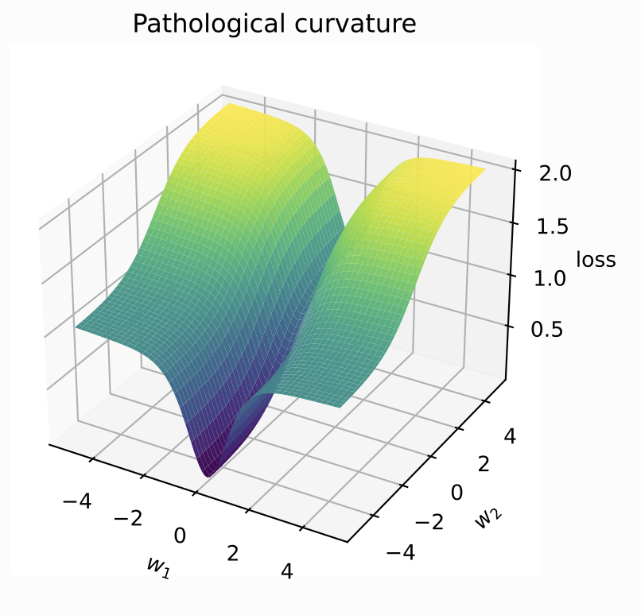
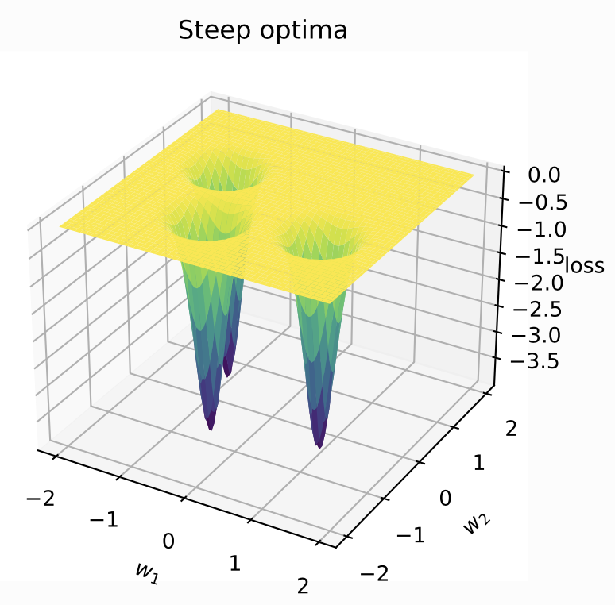
Gradient Descent - The Core Principle
Concept of loss landscapes.
How gradient descent works with a simple visual.
Challenges: vanishing/exploding gradients, saddle points.
Methods to help us reach the smallest loss:
https://uvadlc-notebooks.readthedocs.io/en/latest/tutorial_notebooks/tutorial4/
gradient descent,loss landscapes,challenges
Notes:
So what are some optimization methods?

Slide 18
Gradient Descent - The Core Principle
Refresher:
Methods to help us reach the smallest loss:
- Batch Gradient Descent
aka Gradient Descent,
aka vanilla gradient descent
- Stochastic Gradient Descent (SGD)
- Mini-batch Gradient Descent
- Advanced optimization methods (we’ll see them later)
https://uvadlc-notebooks.readthedocs.io/en/latest/tutorial_notebooks/tutorial4/
gradient descent,loss landscapes,challenges
Notes:
So what are some optimization methods?

Slide 19
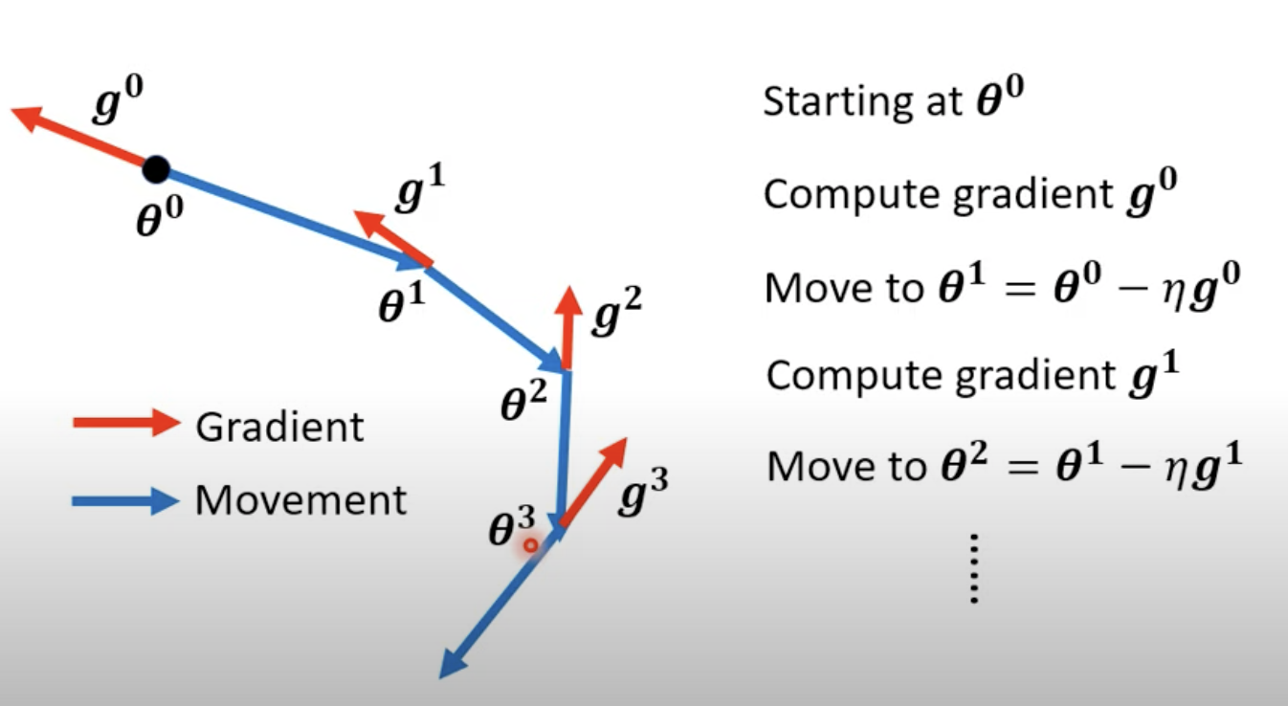
Gradient Descent - The Core Principle
Batch Gradient Descent
Stochastic Gradient Descent (SGD)
Mini-batch Gradient Descent
Repeat N epoch times
Image source: Hung-yi Lee【機器學習2021】機器學習任務攻略
https://www.youtube.com/watch?v=WeHM2xpYQpw&list=PLJV_el3uVTsMhtt7_Y6sgTHGHp1Vb2P2J&index=4
gradient descent,loss landscapes,challenges
Notes:
all three GD methods, follow the same approach
At step = 0, Start at some (initialized) parameters theta_0,
Compute gradient at step = 0
Update theta to theta_1 by moving theta_0 in the negative direction of g_0,
Then compute gradient at step =1 , … repeat N epoch times

Slide 20
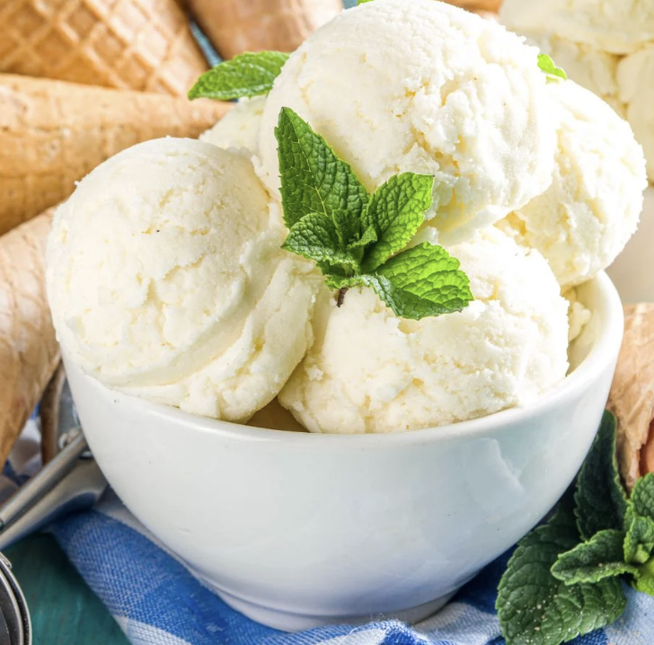
Batch Gradient Descent:
Computes the gradient of the entire dataset and updates the model parameters in the direction of the negative gradient
Pros | Cons
Theoretical convergence guarantees | Can be computationally expensive for large datasets
Stable convergence with a well-chosen learning rate
some dataset
1 batch only
Key takeaway: (Batch) Gradient Descent looks at all the data points in one epoch and then makes the updates
one epoch

Slide 21
Stochastic Gradient Descent (SGD):
Updates the model parameters by computing the gradient of the cost wrt a single data point randomly chosen from the dataset.
Pros | Cons
Can be faster than GD because it updates the parameters more frequently | Can have a lot of variance in updates leading to a less stable convergence
Due to its inherent noise (randomness), it can escape the shallow local minima more easily | Often requires a descreasing learning rate to ensure convergence
some dataset with size L
L batches
Key takeaway: Stochastic Gradient Descent looks at one randomly chosen data point in one epoch and then makes the updates.
Repeat this L numer of times (epoch = L).
Makes L number of updates
L number of epoches
batch gradient descent,stochastic gradient descent,mini-batch gradient descent
Notes:
If the size of the dataset is L = 256, then
SGD has 256 epochs, and in each epoch SGD looks at only 1 data point and makes the update

Slide 22
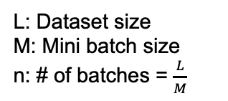
Mini-Batch Gradient Descent:
Divides the dataset into small batches and updates the model parameters using the gradient of these batches. It uses subsets (instead of from the full dataset or from single points) to update its parameters.
Pros | Cons
Can be benefit from hardware optimziation in matrix operation (GPU acceleration) | Mini-batch size is an additional hyperparameter to tune
Typically converges faster than both GD and SGD as it balances the advantages of both | Maybe more?
some dataset with size L
n batches
one epoch
Key takeaway: Mini-Batch Gradient Descent uses a subset of the dataset (larger than one but smaller than the entire dataset) to compute the gradient and update parameters
L: Dataset size
M: Mini batch size
n: # of batches = $\frac{L}{M}$

Slide 23
Advanced Optimization Algorithms
Gradient Descent + Momentum: Concept of using previous gradients to inform the current step. Benefits over standard SGD.
Adagrad: Adaptive learning rates & how it helps in optimization.
RMSprop: Overcoming Adagrad's aggressive, monotonically decreasing learning rate.
Adam (Adaptive Moment Estimation): Combining Momentum & RMSprop. Importance & advantages in deep learning.
momentum,adagrad,rmsprop,adam

Slide 24
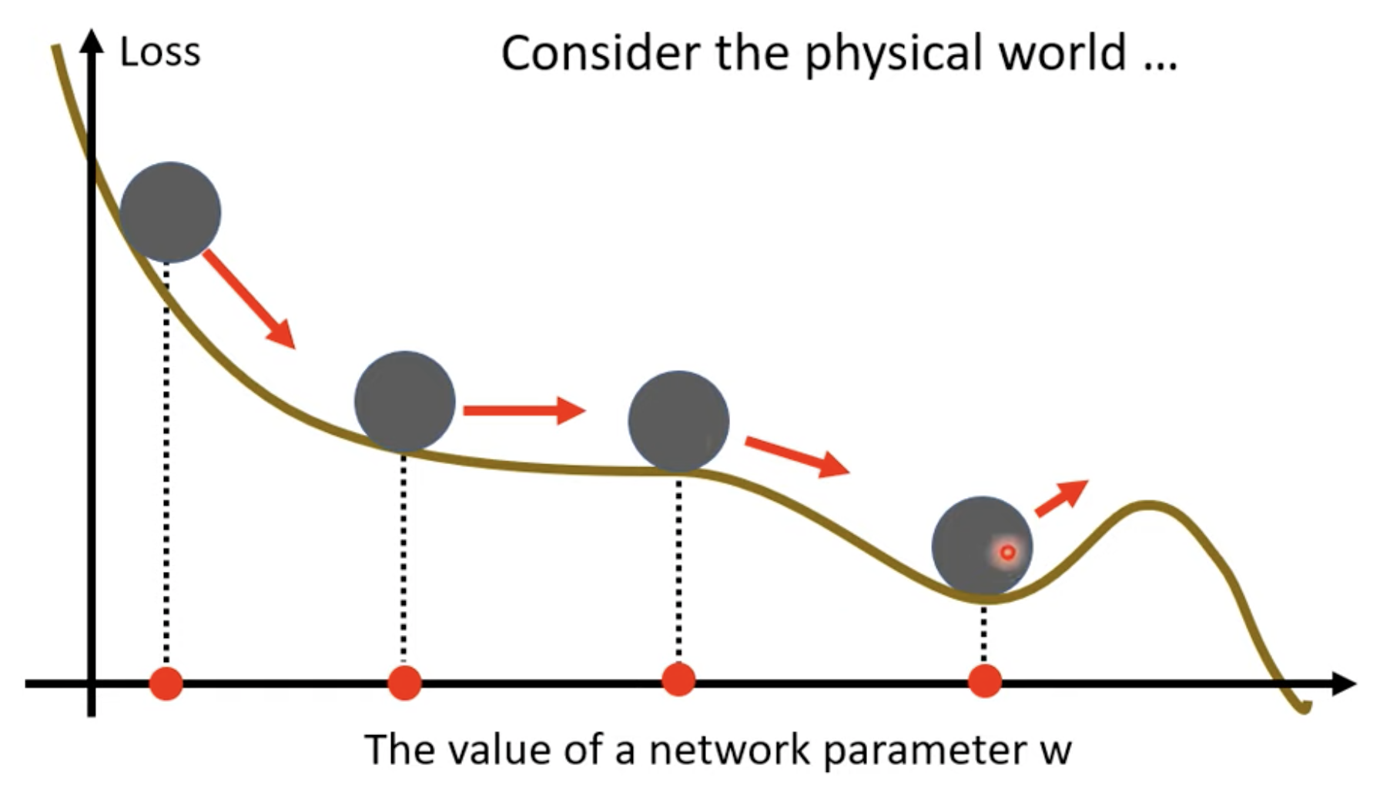
Advanced Optimization Algorithms
Gradient Descent + Momentum:
Movement of last step minus gradient at present
Notes:
Imagine we roll a ball down this curve, when it hits this local minima, it doesn’t just stop there, the momentum will perhaps carry the ball forward,
And helps this ball escaping the local minima.

Slide 25
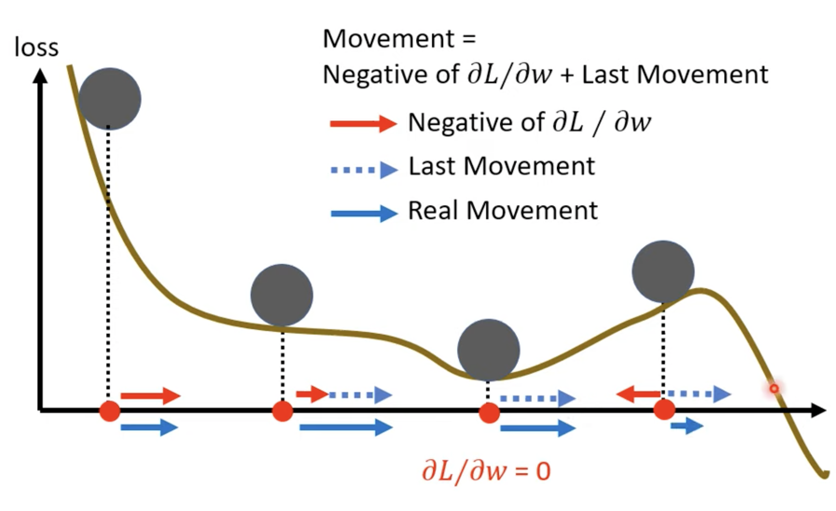
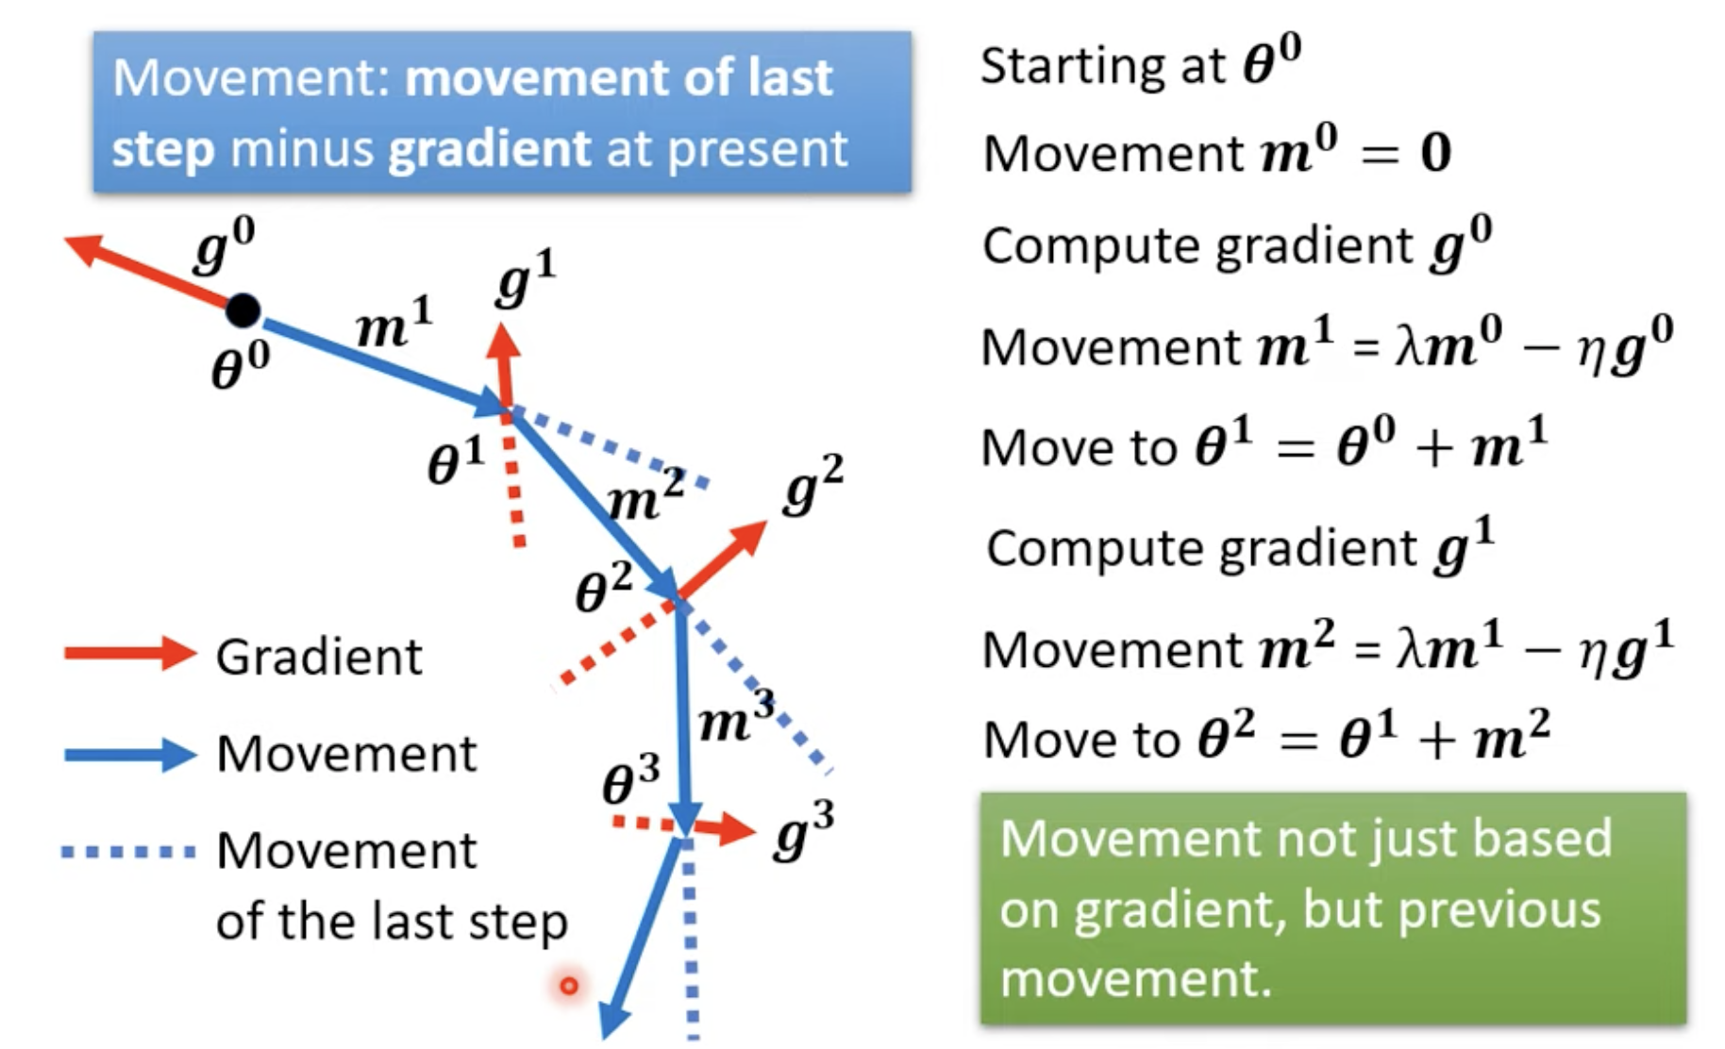
Advanced Optimization Algorithms
Gradient Descent + Momentum:
Update theta
Real movement =
Last movement + negative gradient
Image source: Hung-yi Lee【機器學習2021】機器學習任務攻略
https://www.youtube.com/watch?v=WeHM2xpYQpw&list=PLJV_el3uVTsMhtt7_Y6sgTHGHp1Vb2P2J&index=4
Notes:
In gradient descent with momentum,
We start at theta_0, and since this is the start, movement at step 0 is 0,
We compute gradient g_0,
Then we compute movement at the next step, step1,
Movement_1 = lambda * m_0 minus eta * g_0.

Slide 26
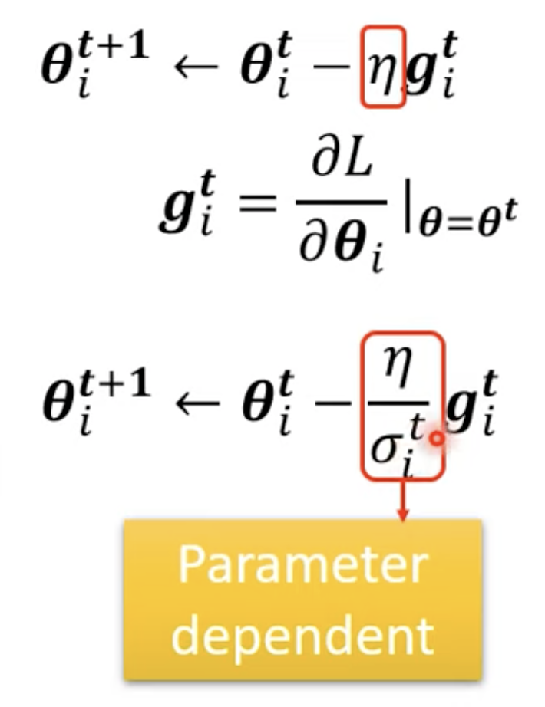
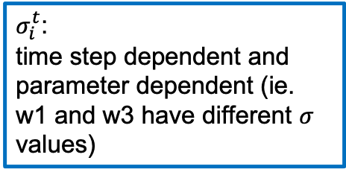
Advanced Optimization Algorithms
Adaptive Learning Rate
Here we rewrite the updating step as the one on the right:
$σ_{i}^{t}$:
time step dependent and parameter dependent (ie. w1 and w3 have different $σ$ values)
Image source: Hung-yi Lee【機器學習2021】機器學習任務攻略
https://www.youtube.com/watch?v=WeHM2xpYQpw&list=PLJV_el3uVTsMhtt7_Y6sgTHGHp1Vb2P2J&index=4

Slide 27
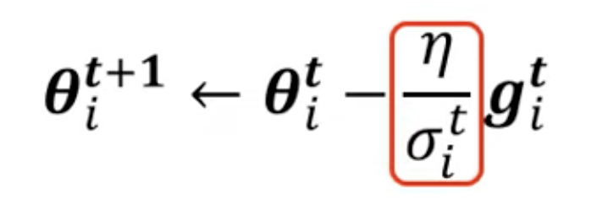
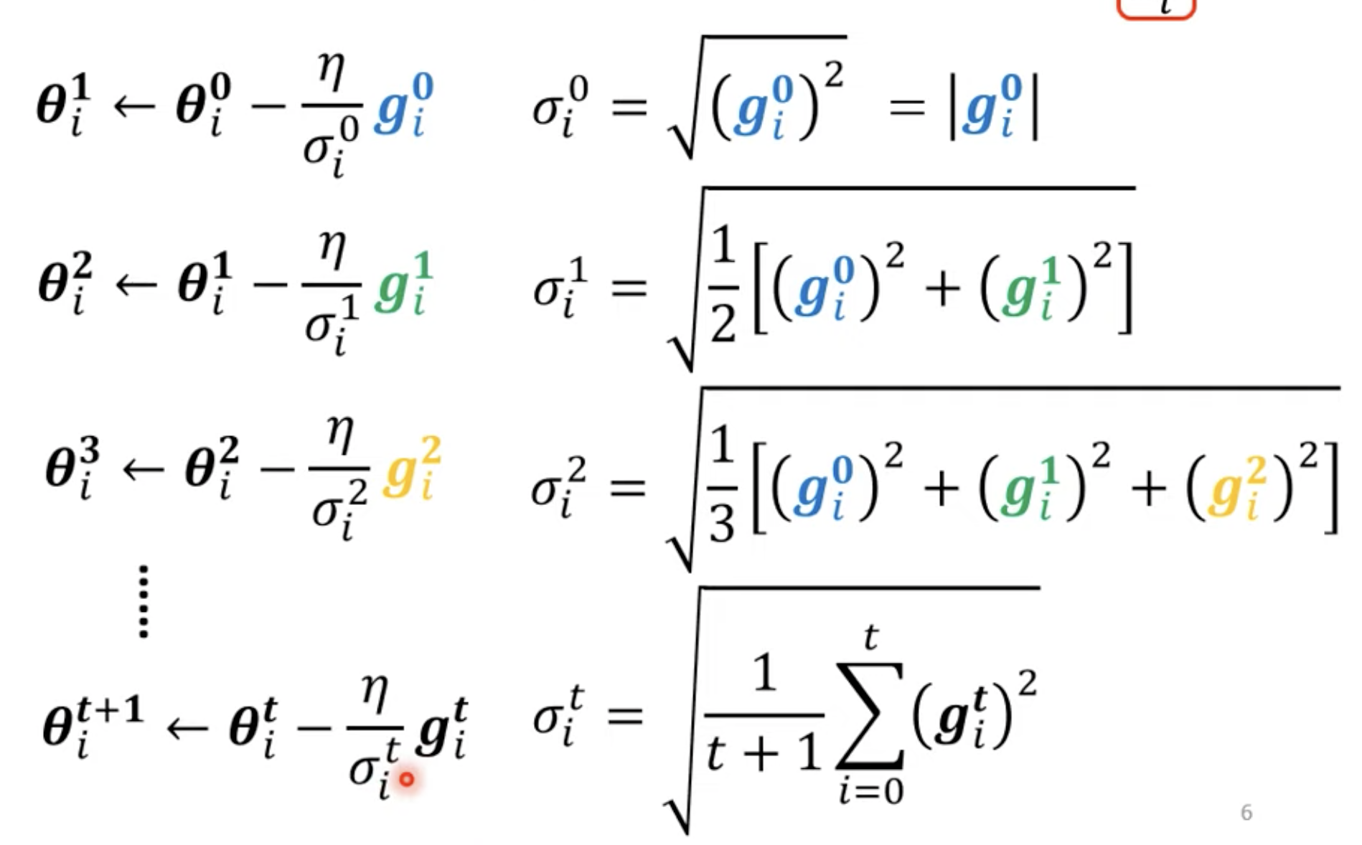
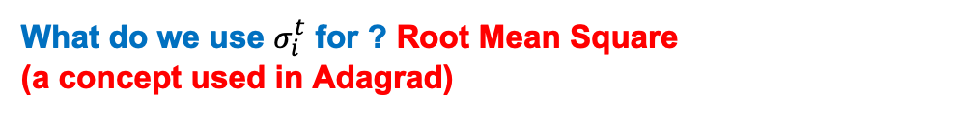
Advanced Optimization Algorithms
What do we use $σ_{i}^{t}$ for ? Root Mean Square
(a concept used in Adagrad)
Calculate g_0
Calculate sigma_0
Update theta_1
Calculate g_1
… repeat
Image source: Hung-yi Lee【機器學習2021】機器學習任務攻略
https://www.youtube.com/watch?v=WeHM2xpYQpw&list=PLJV_el3uVTsMhtt7_Y6sgTHGHp1Vb2P2J&index=4

Slide 28
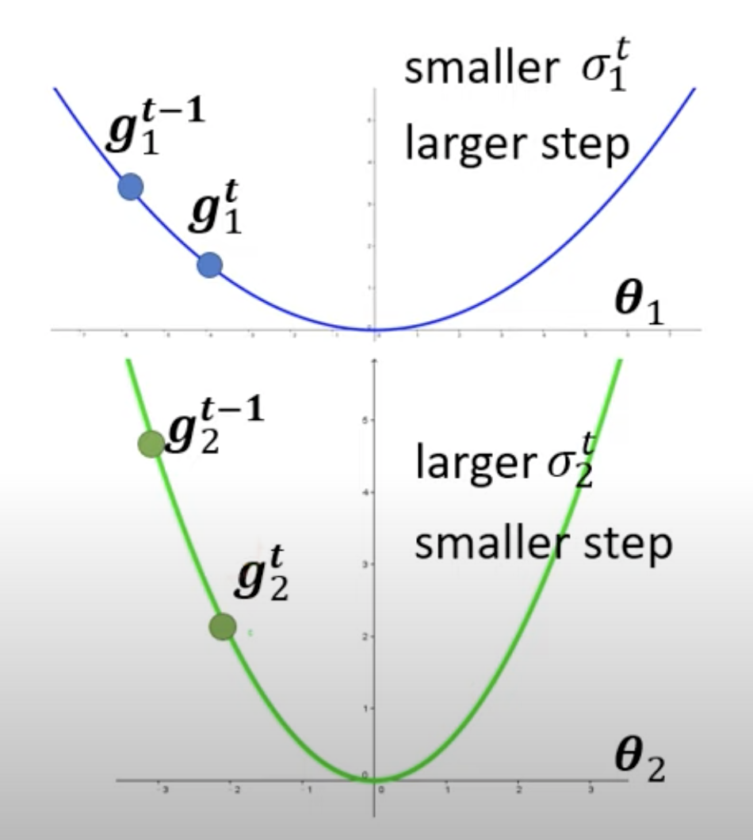
Advanced Optimization Algorithms
Why is this “adaptive” ?
Image source: Hung-yi Lee【機器學習2021】機器學習任務攻略
https://www.youtube.com/watch?v=WeHM2xpYQpw&list=PLJV_el3uVTsMhtt7_Y6sgTHGHp1Vb2P2J&index=4
Notes:
On a flatter surface, we want to move faster -> higher learning rate
On theta1, because slope is smaller, according to this formula, sigmas are all smaller,
Smaller sigma leads to a larger eta learning rate.
And vice versa, on theta2, the slopes are much greater, steeper, and thus sigmas are much higher,
Higher sigma leads to a smaller eta learning rate.
Thus this is adatpive

Slide 29
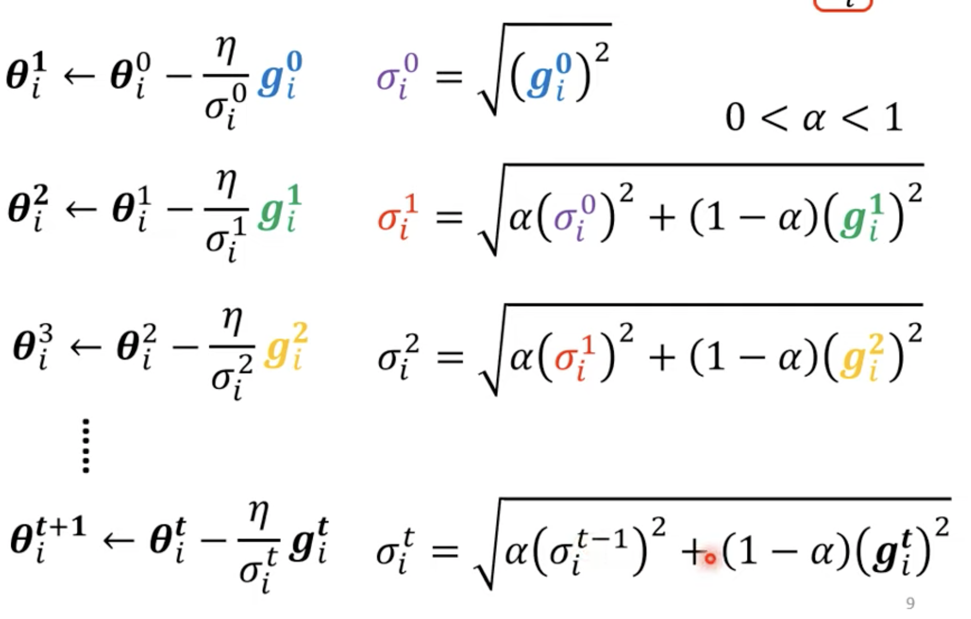
Advanced Optimization Algorithms
RMSProp:
The recent gradient has larger influence, and the past gradients have less influence
Sigmas are calculated differently after step 0.
Image source: Hung-yi Lee【機器學習2021】機器學習任務攻略
https://www.youtube.com/watch?v=WeHM2xpYQpw&list=PLJV_el3uVTsMhtt7_Y6sgTHGHp1Vb2P2J&index=4
Notes:
Alpha: another hyperparameter, determines how much weight should the current gradient take

Slide 30
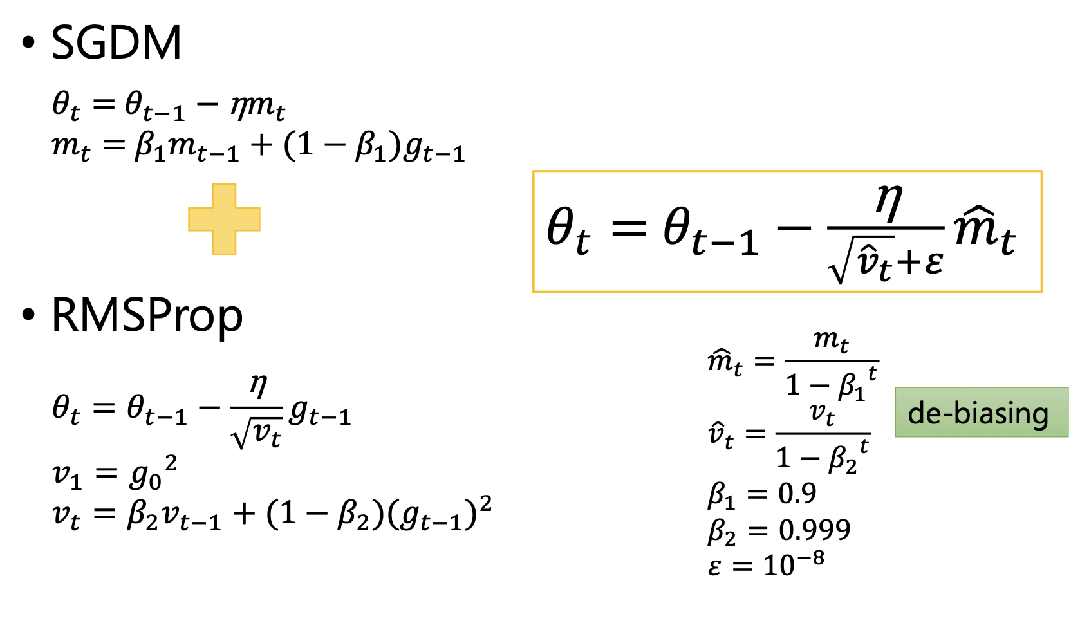
Advanced Optimization Algorithms
Adam:
RMSProp + Momentum
The purpose of dividing by beta is so that the m term (and the v term) doesn’t fluncuate too much over time
Image source: Hung-yi Lee【機器學習2021】機器學習任務攻略
https://www.youtube.com/watch?v=WeHM2xpYQpw&list=PLJV_el3uVTsMhtt7_Y6sgTHGHp1Vb2P2J&index=4
Notes:
Beta_1 is a value less than 1, and since m_t accumulates over time, so at early time steps,
The purpose of dividing by beta is so that the m term doesn’t fluncuate too much over time

Slide 31
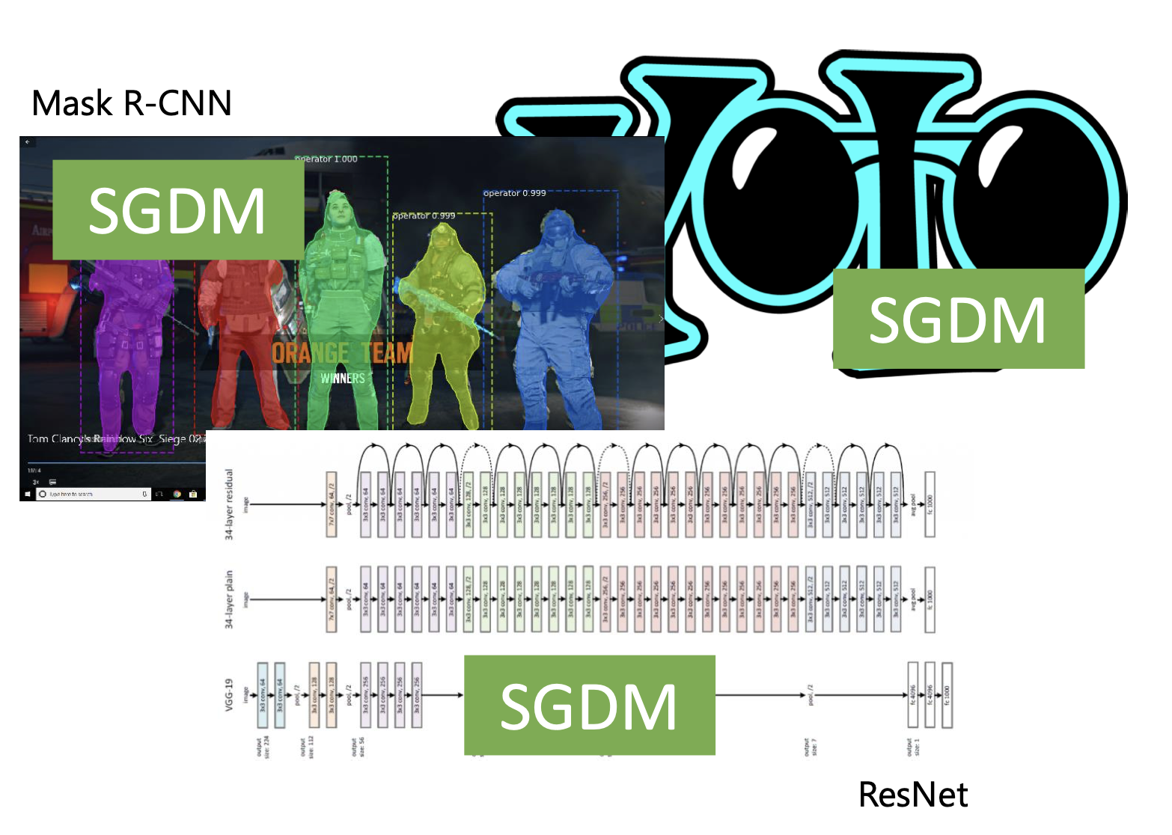
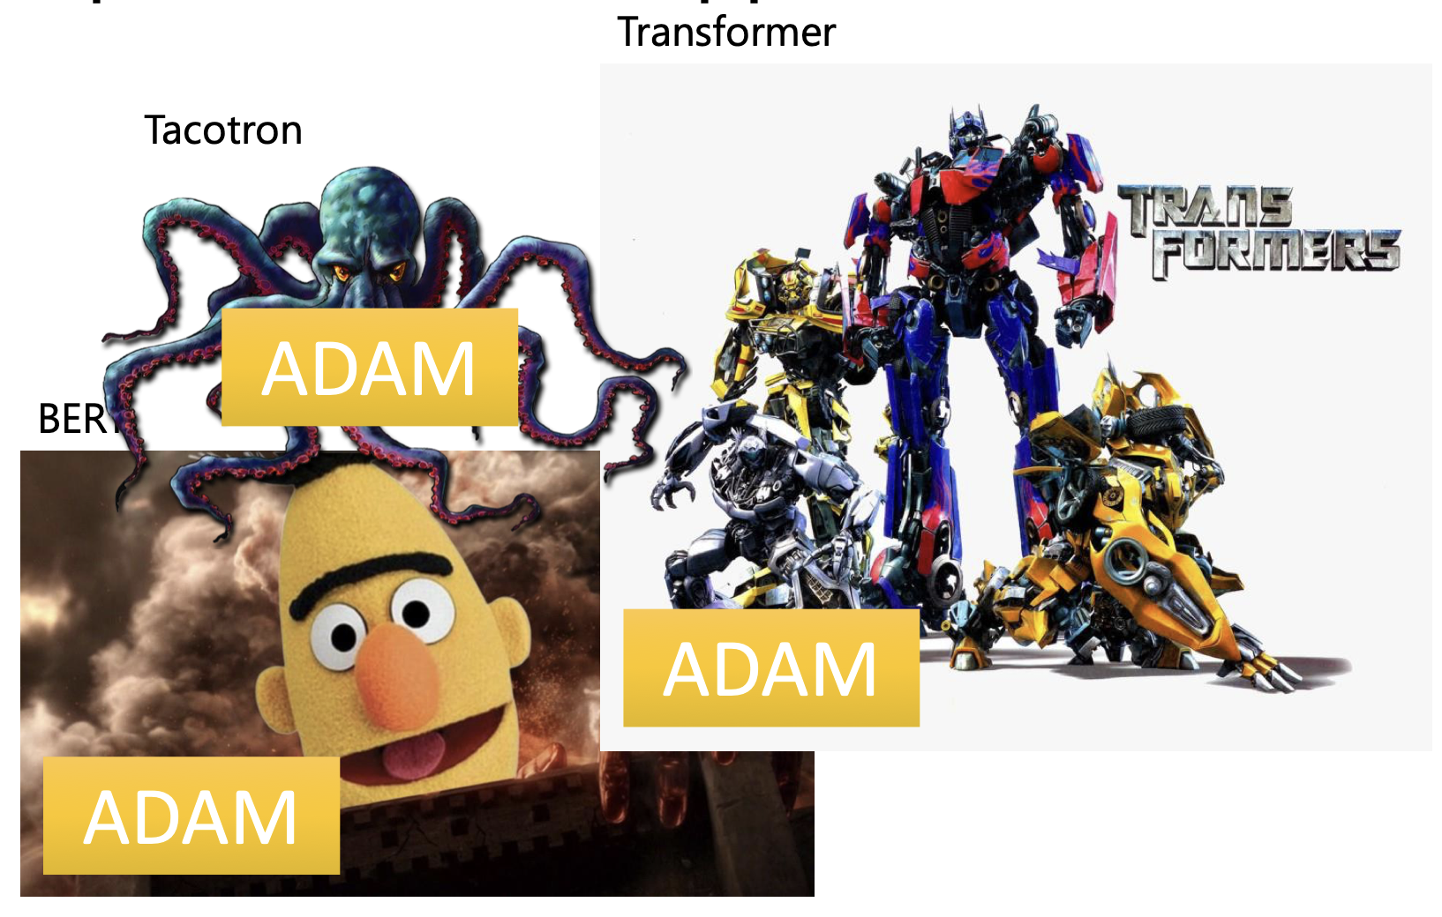
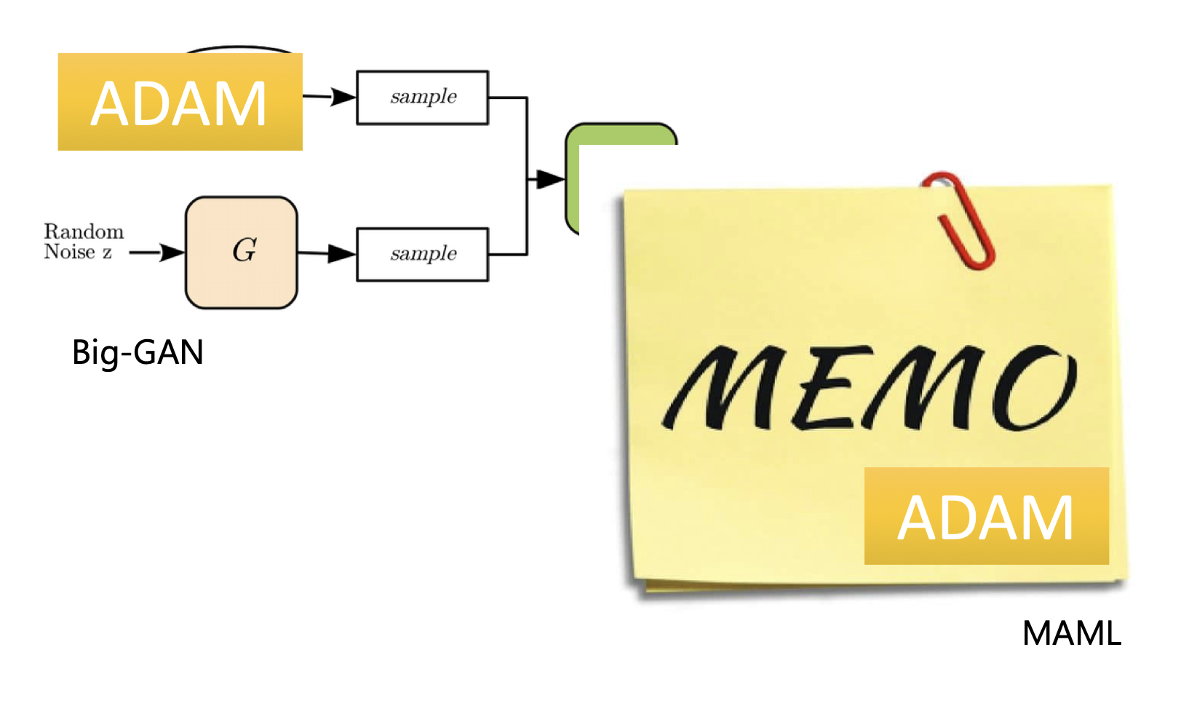
Optimizers: Real Application
Image source: Hung-yi Lee【機器學習2021】機器學習任務攻略
Notes:
Beta_1 is a value less than 1, and since m_t accumulates over time, so at early time steps,
The purpose of dividing by beta is so that the m term doesn’t fluncuate too much over time

Slide 32
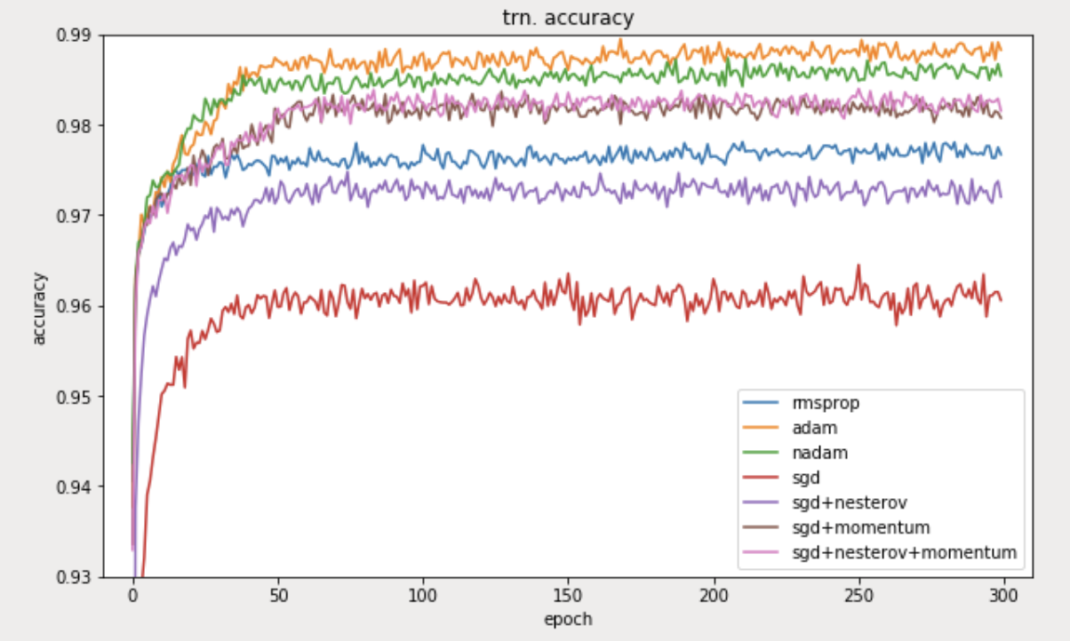
Which optimizer to pick? Adam or SGDM?
SGD > Adam?? Which One Is The Best Optimizer: Dogs-VS-Cats Toy Experiment
https://shaoanlu.wordpress.com/2017/05/29/sgd-all-which-one-is-the-best-optimizer-dogs-vs-cats-toy-experiment/
SGDM vs Adam

Slide 33
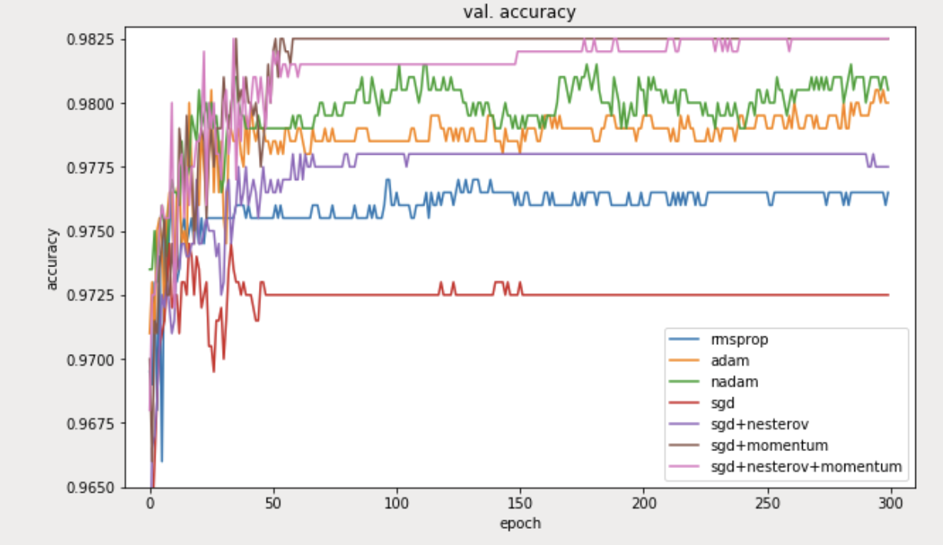
Which optimizer to pick? Adam or SGDM?
SGD > Adam?? Which One Is The Best Optimizer: Dogs-VS-Cats Toy Experiment
https://shaoanlu.wordpress.com/2017/05/29/sgd-all-which-one-is-the-best-optimizer-dogs-vs-cats-toy-experiment/
Notes:
Beta_1 is a value less than 1, and since m_t accumulates over time, so at early time steps,
The purpose of dividing by beta is so that the m term doesn’t fluncuate too much over time

Slide 34
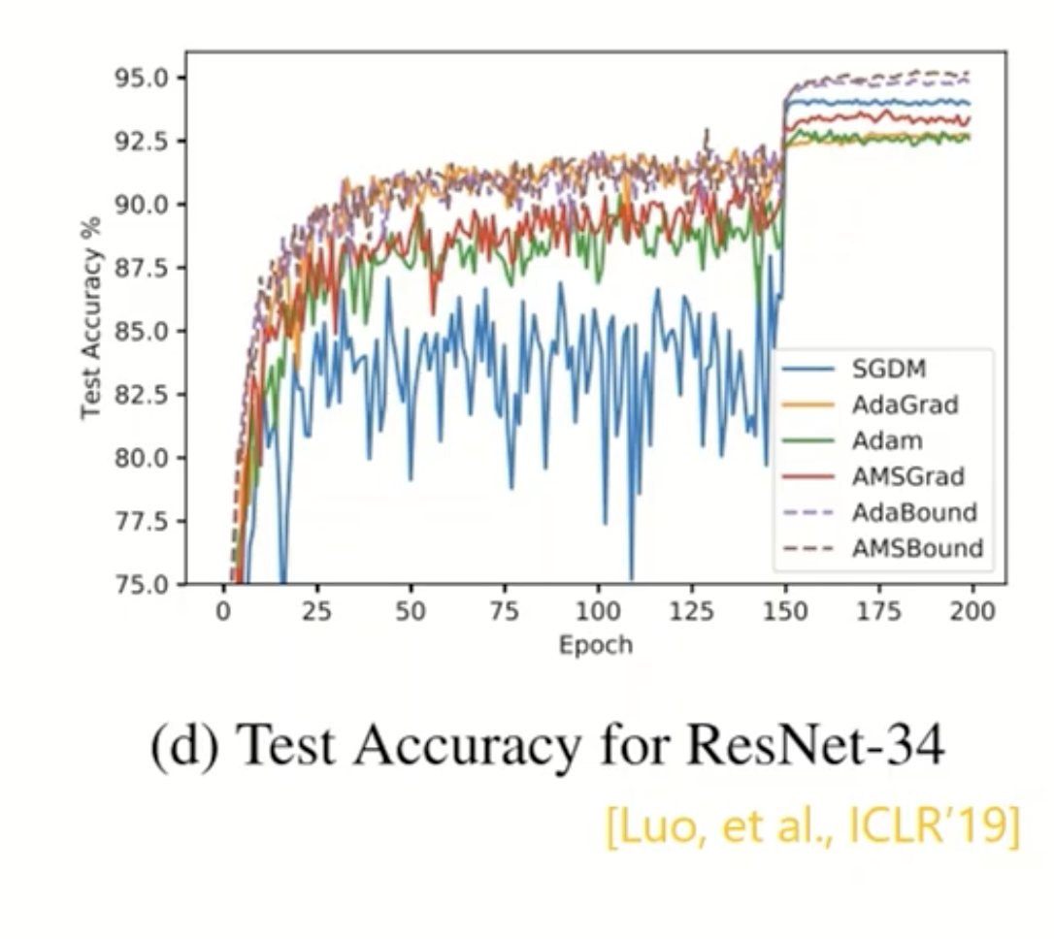
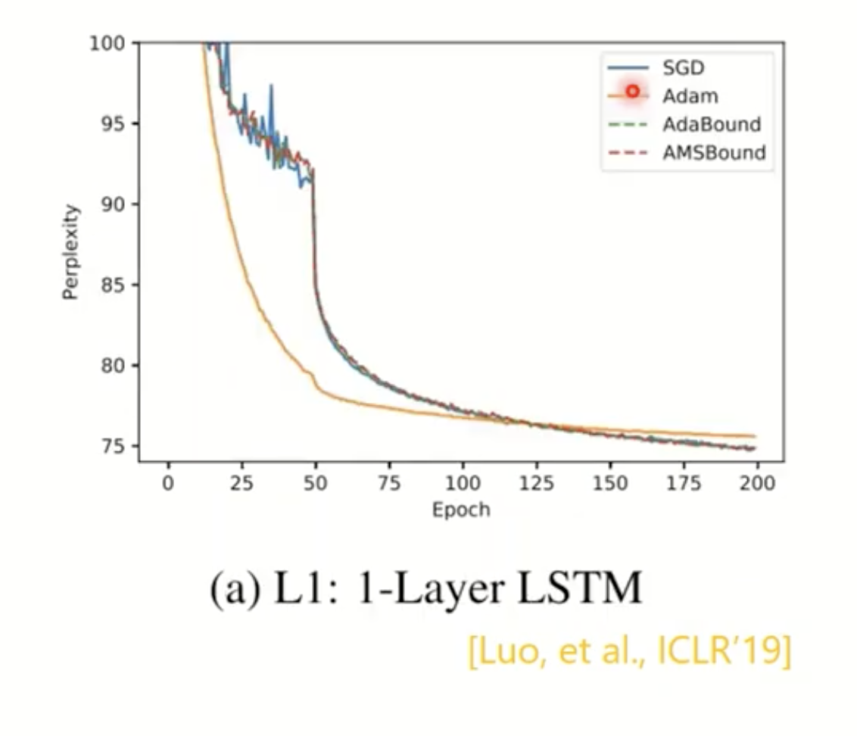
Which optimizer to pick? Adam or SGDM?
Perplexity: a metrics used in LLM evaluation; lower the better
Image source: Hung-yi Lee【機器學習2021】機器學習任務攻略

Slide 35
Which optimizer to pick? Adam or SGDM?
What have we seen?
Adam: fast training, larger generalization gap, unstable
SGDM: more stable, smaller generalization gap, slightly better convergence
Image source: Hung-yi Lee【機器學習2021】機器學習任務攻略
Notes:
Beta_1 is a value less than 1, and since m_t accumulates over time, so at early time steps,
The purpose of dividing by beta is so that the m term doesn’t fluncuate too much over time

Slide 36
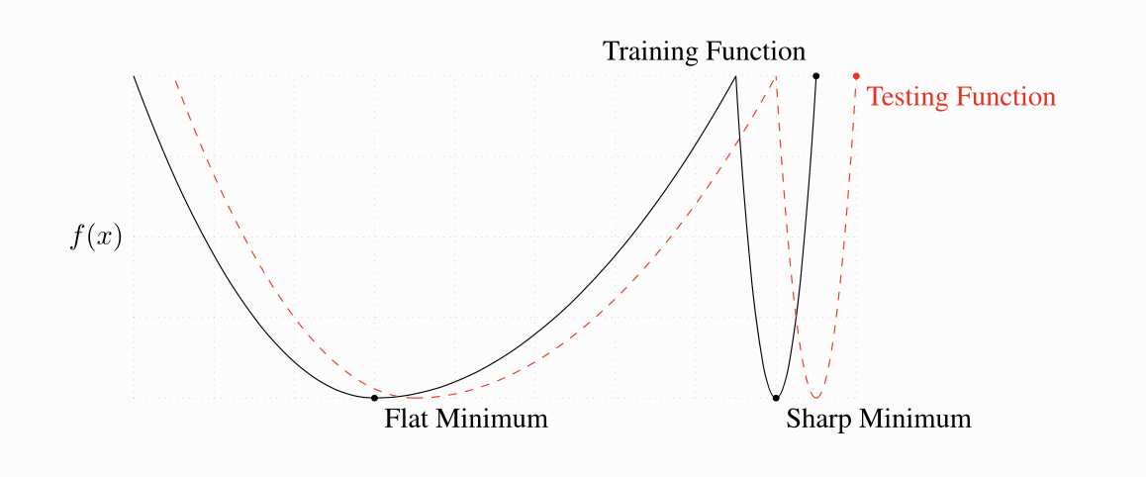
What optimizer to take?
ON LARGE-BATCH TRAINING FOR DEEP LEARNING: GENERALIZATION GAP AND SHARP MINIMA
https://arxiv.org/pdf/1609.04836
What’s generalization gap?
Flat minimum
vs.
Sharp minimum
momentum,adagrad,rmsprop,adam
Notes:
Black line is the training loss surface, red dotted is testing loss.
Finding a sharp minima can be helpful for finding the minimal training loss, but this doesn’t mean that the set of parameters at this minima also
Minimizes the test loss.
On the other hand, a flat minima is more robust to this difference.

Slide 37
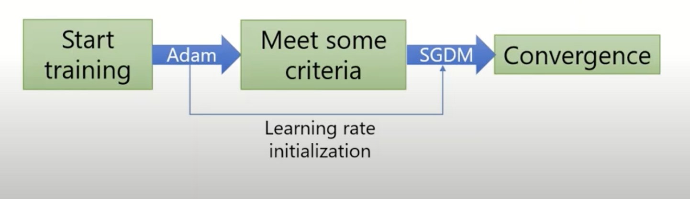
Simply combine Adam with SGDM?
SWAT [Keskar, et al., arXiv’17]
Begin with Adam (fast) , end with SGDM
momentum,adagrad,rmsprop,adam
Notes:
When to switch ?
Something to look into later

Slide 38
What are other optimization methods?
SGD | Adam
SGD | Adagrad
SGDM | RMSProp
Learning rate scheduling | Adam
NAG | AMSGrad
SGDWM | AdaBound
 | Learning rate scheduling
 | RAdam
 | Nadam
 | AdamW
SWATS
Lookahead
momentum,adagrad,rmsprop,adam

Slide 39
Something that helps optimization
Shuffling
Dropout
Warm-up
Curriculum Learning: train your model with easy data first, then difficult data
Fine-tuning
Normalization
Regularization
early stopping,dropout,weight decay,regularization

Slide 40
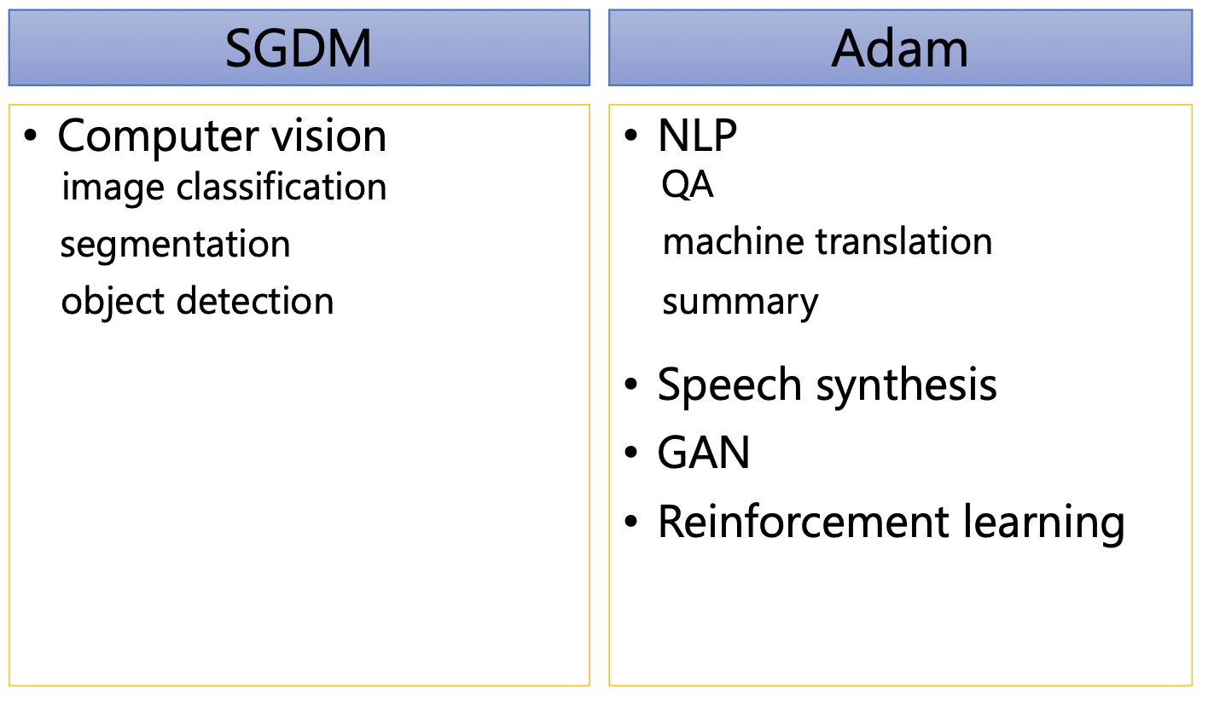
Conclusion
No “one optimizer fits all” optimizer
conclusion,optimization techniques

